Slide 1

ORACLE WEBSITE
PREPARED BY
DASARAPALLI DIVAKAR
JALLA MAMATHA
MADHURI KUNAM

Slide 2
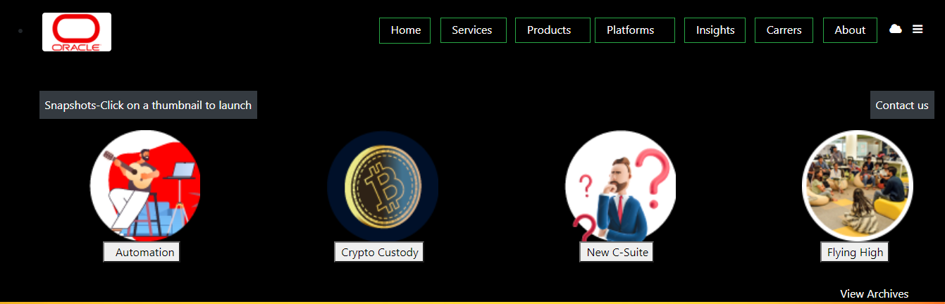
Home Page
Header Part

Slide 3
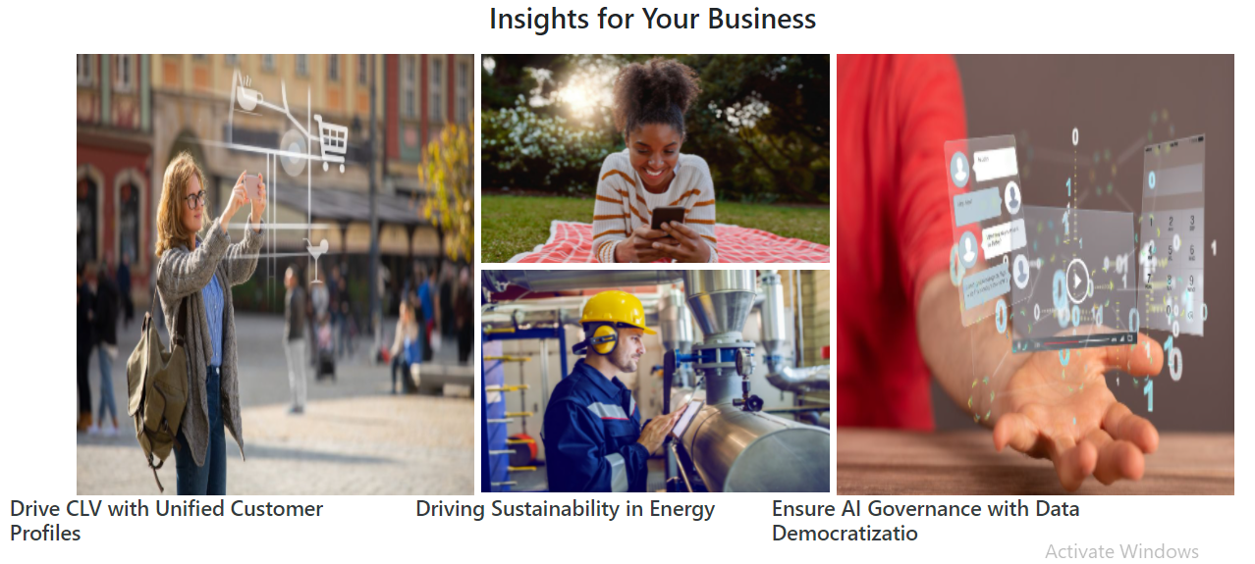
Home Page – Insights for Your Business

Slide 4
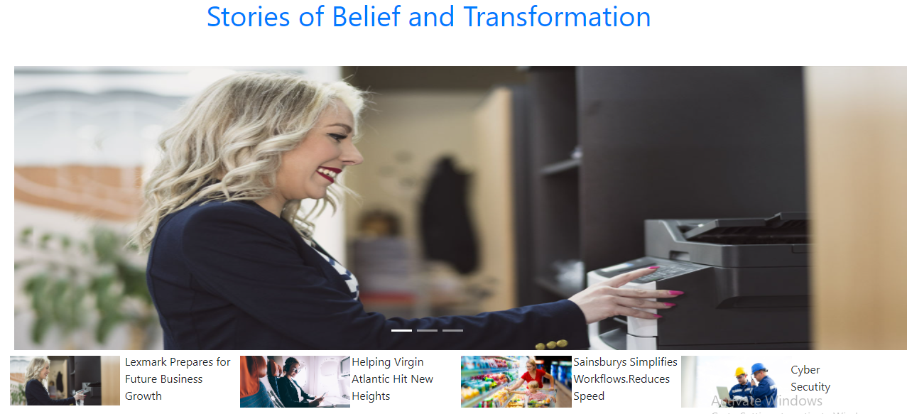

Home Page

Slide 5
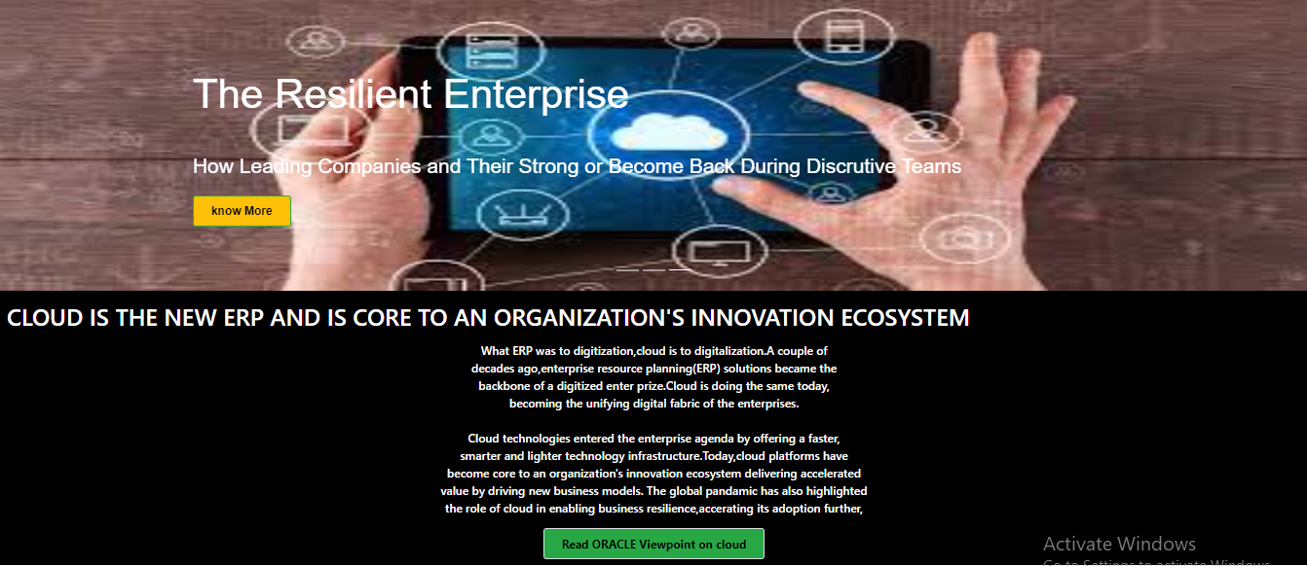
Services Page

Slide 6
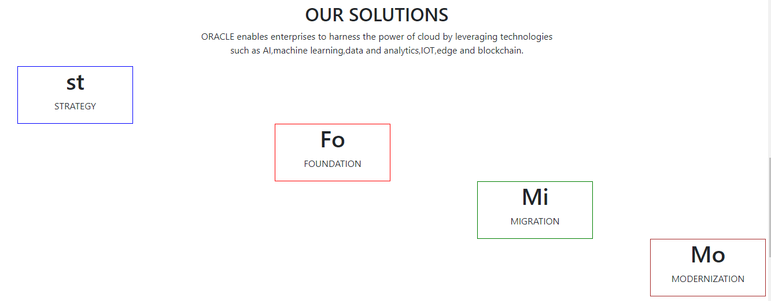
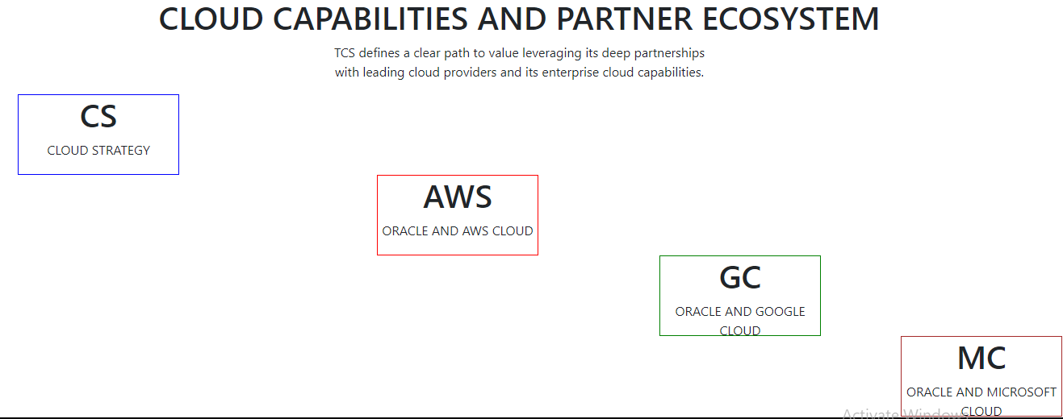
Services Page

Slide 7

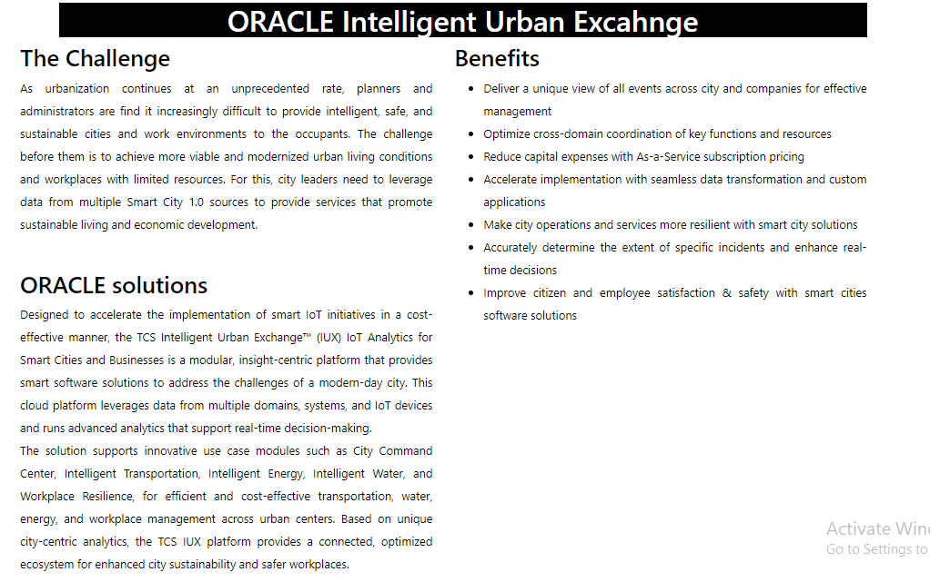
Products Page

Slide 8

Products Page

Slide 9
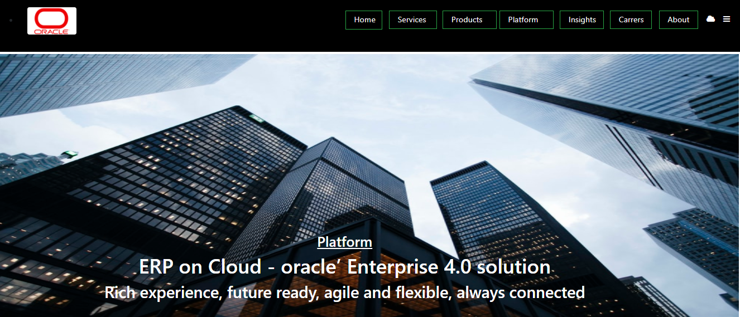
Platforms Page

Slide 10
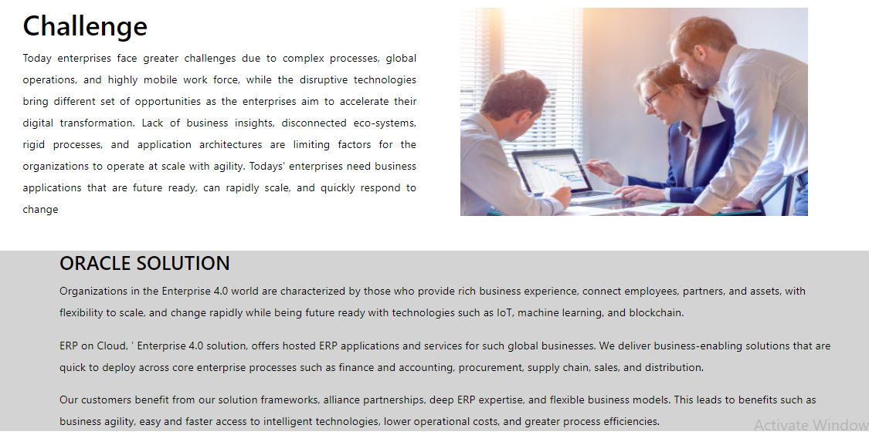
Platforms Page

Slide 11

Platforms Page

Slide 12
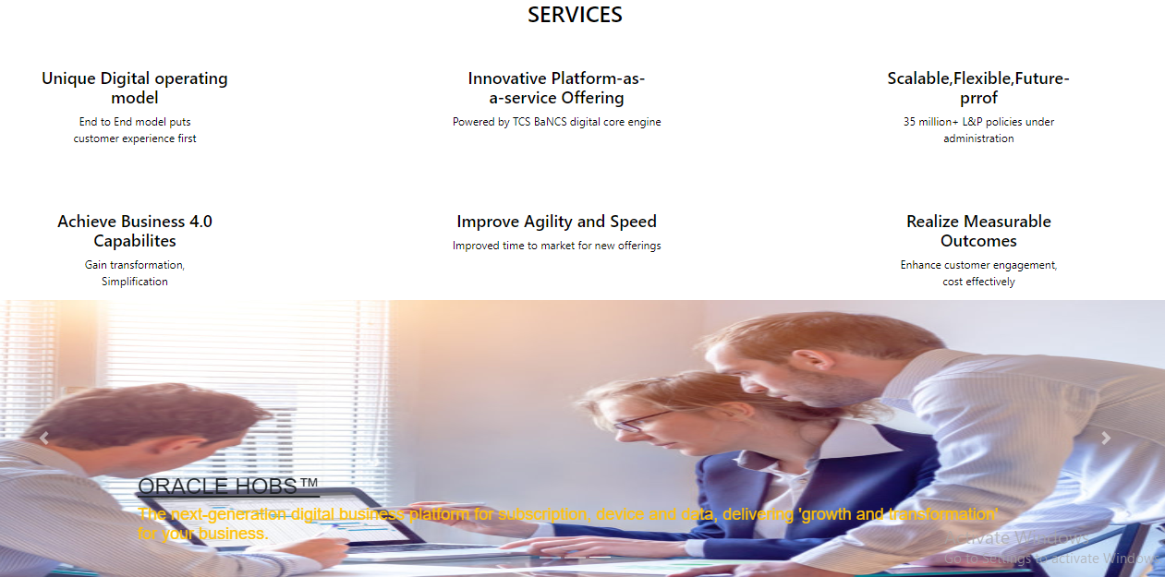
Platforms Page

Slide 13
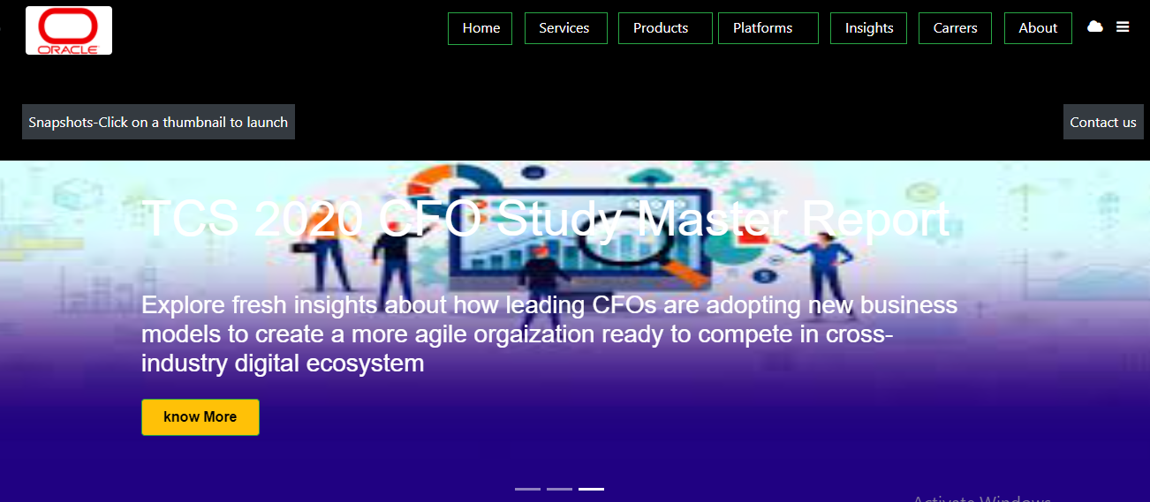
Insights Page

Slide 14
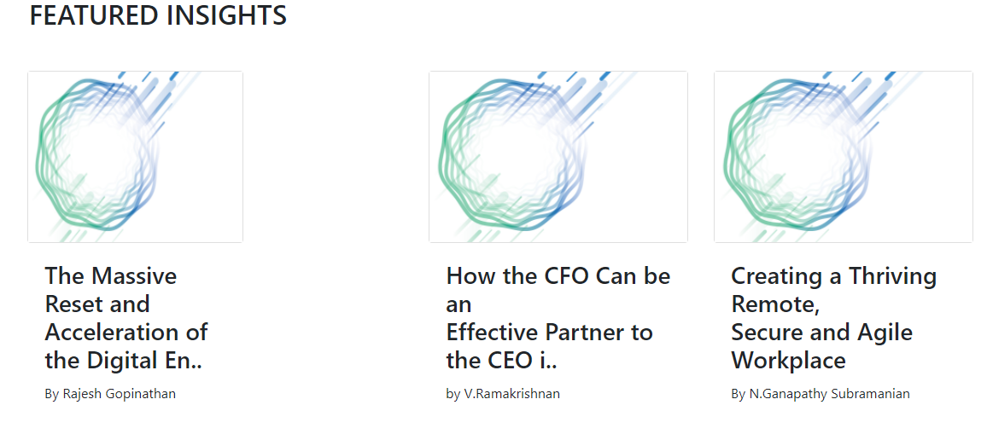
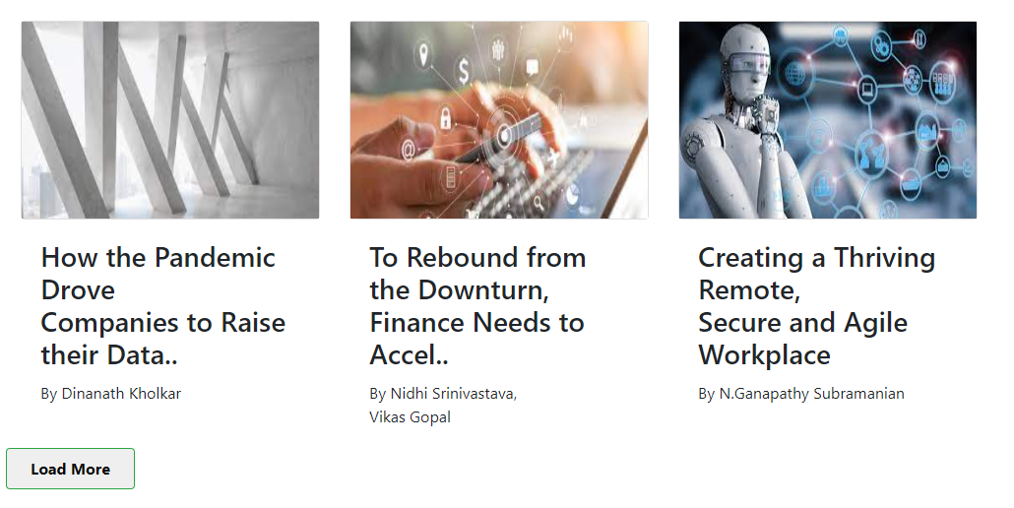
Insights Page

Slide 15
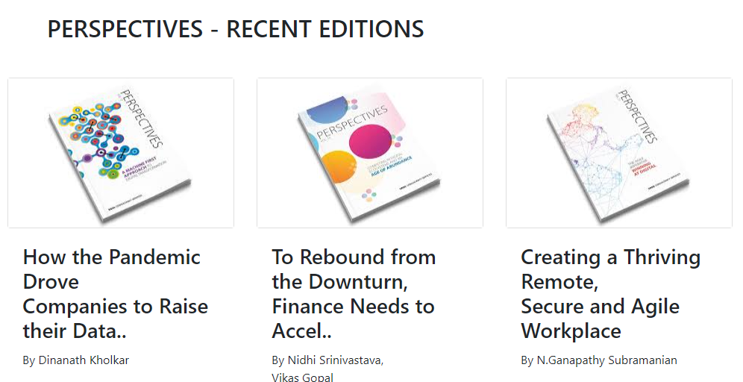
Insights Page

Slide 16
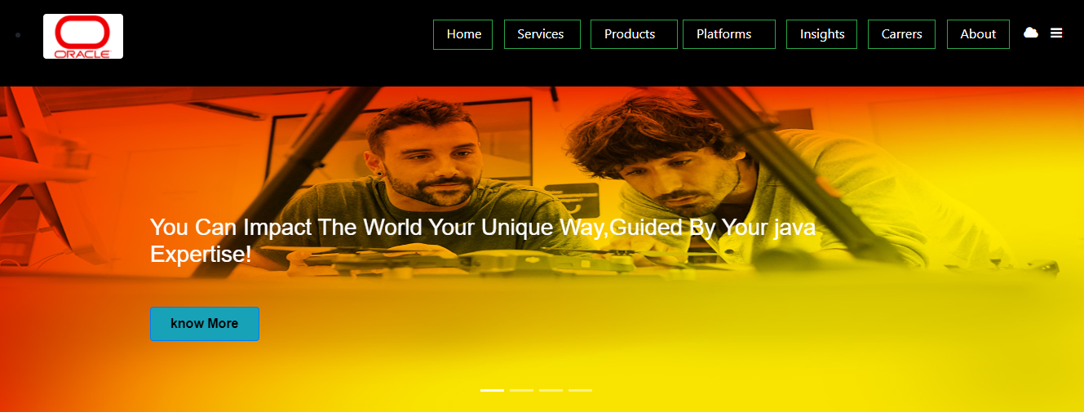
Careers Page

Slide 17
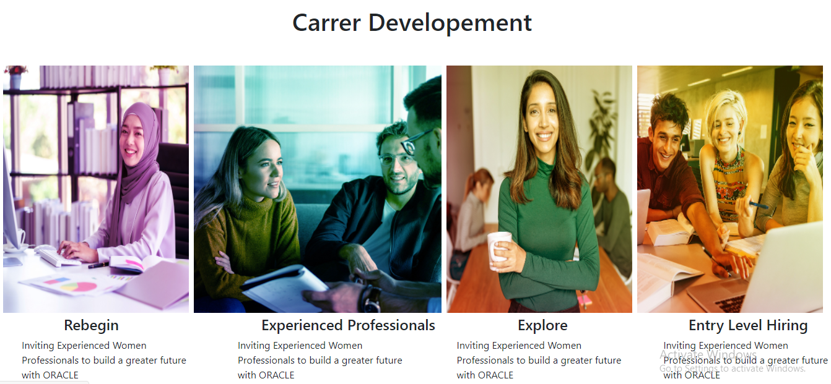
Careers Page

Slide 18

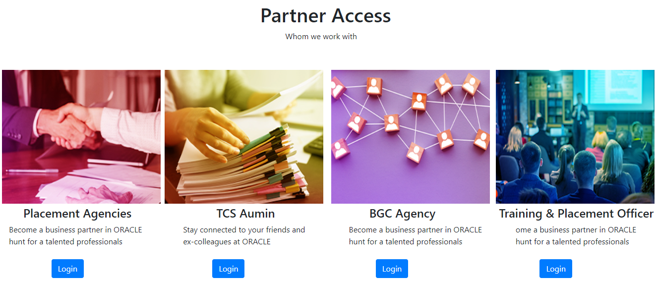
Careers Page

Slide 19
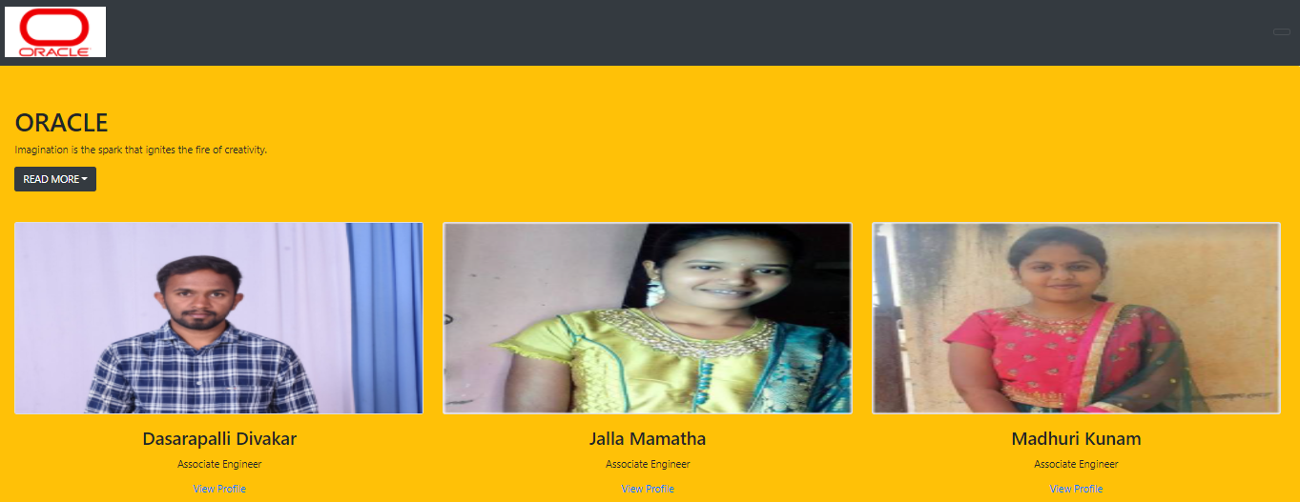
About Page

Slide 20
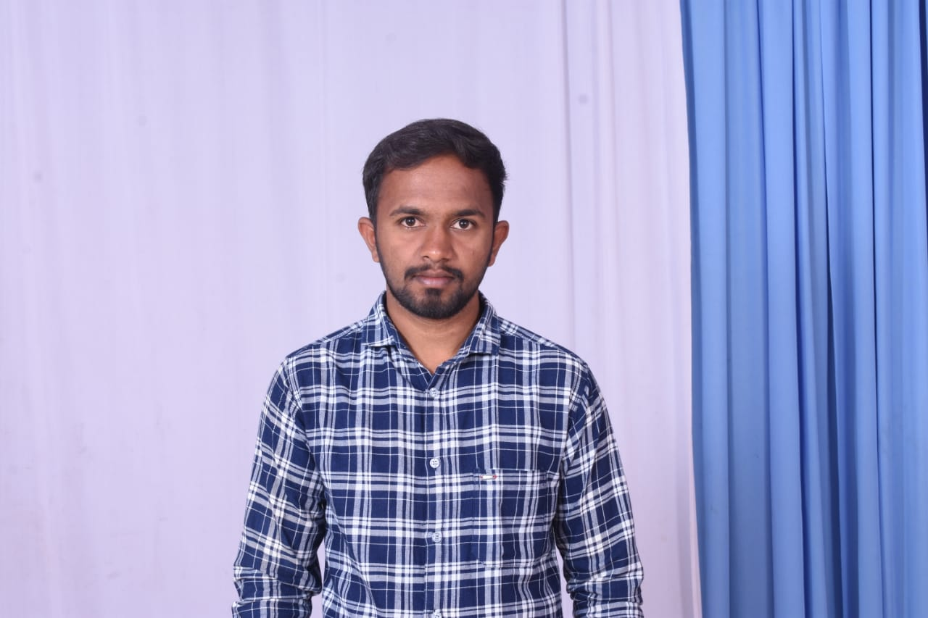
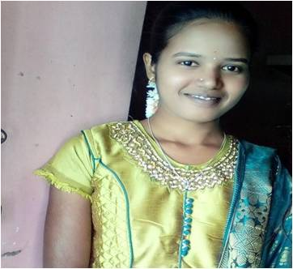
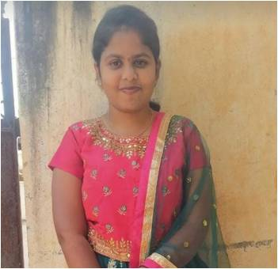
OUR TEAM
DASARAPALLI DIVAKAR
Associate Engg. Virtusa
Jalla Mamatha
Associate Engg. Virtusa
Madhuri Kunam
Associate Engg. Virtusa

Slide 21
THANK YOU

